Slide 1

Basic HTML and CSS
CAP 5738 Data Visualization
Spring 2018
Dr. Sayeed S. Alam

Slide 2
Create your web application
Download nodejs from https://nodejs.org/en/download/
You may download installer (.msi) or zip file
Install / Unzip nodejs

Slide 3
Install NodeJS Http-server
Run “Command Prompt”
Run : “cd <nodejs directory>”
You have installed/unzipped nodejs to c:\NodeJS then:
Run: “cd c:\nodeJS”
Then Run: “npm install http-server –g”

Slide 4
Run your web application
Create a folder.
Add the following directories:
images
css
js
Add file:
Index.html
Go to NodeJS directory:
Run: “http-server <folder_path> -p <port>”
Use a safe port number. E.g. 1337/9080

Slide 5
HTML
Sample:
<!DOCTYPE html>
<html>
<head>
<title>This is document title</title>
</head>
<body>
<h1>This is a heading</h1>
<p>Document content goes here.....</p>
</body>
</html>
This is a heading
Document content goes here.....

Slide 6
Tag Glossary
<html> : This tag encloses the complete HTML document and mainly comprises of document header which is represented by <head>...</head> and document body which is represented by <body>...</body> tags.
<head>: This tag represents the document's header which can keep other HTML tags like <title>, <link> etc.
<title> The <title> tag is used inside the <head> tag to mention the document title.
<body> This tag represents the document's body which keeps other HTML tags like <h1>, <div>, <p> etc.
<h1> This tag represents the heading.
<p> This tag represents a paragraph.

Slide 7
Basic Tags – Heading Tags
<!DOCTYPE html>
<html>
<head>
<title>Heading Example</title>
</head>
<body>
<h1>This is heading 1</h1>
<h2>This is heading 2</h2>
<h3>This is heading 3</h3>
<h4>This is heading 4</h4>
<h5>This is heading 5</h5>
<h6>This is heading 6</h6>
</body>
</html>
This is heading 1
This is heading 2
This is heading 3
This is heading 4
This is heading 5
This is heading 6

Slide 8
Paragraph Tags
The <p> tag offers a way to structure your text into different paragraphs.
<!DOCTYPE html>
<html>
<head>
<title>Paragraph Example</title>
</head>
<body>
<p>Here is a first paragraph of text.</p>
<p>Here is a second paragraph of text.</p>
<p>Here is a third paragraph of text.</p>
</body>
</html>

Slide 9
Grouping Contents
<div>, <span>
<div id = "menu" align = "middle" >
<a href = "/index.htm">HOME</a> |
<a href = "/about/contact_us.htm">CONTACT</a> |
<a href = "/about/index.htm">ABOUT</a>
</div>
<div id = "content" align = "left" bgcolor = "white">
<h5>Content Articles</h5>
<p>Actual content goes here.....</p>
</div>

Slide 10
Images
<img src = "/html/images/test.png" alt = "Test Image" />

Slide 11
Tables
<table border = "1">
<tr>
<td>Row 1, Column 1</td>
<td>Row 1, Column 2</td>
</tr>
<tr>
<td>Row 2, Column 1</td>
<td>Row 2, Column 2</td>
</tr>
</table>

Slide 12
Lists
<ul> - An unordered list. This will list items using plain bullets.
<ol> - An ordered list. This will use different schemes of numbers to list your items.
<dl> - A definition list. This arranges your items in the same way as they are arranged in a dictionary.
<ul>
<li>Beetroot</li>
<li>Ginger</li>
<li>Potato</li>
<li>Radish</li>
</ul>

Slide 13
Type Attributes
<ul>:
disc,
square
Circle
<ol>:
<ol type = "1"> - Default-Case Numerals.
<ol type = "I"> - Upper-Case Numerals.
<ol type = "i"> - Lower-Case Numerals.
<ol type = "A"> - Upper-Case Letters.
<ol type = "a"> - Lower-Case Letters.
What happens for <ol type = "i" start = "4"> ?

Slide 14
Definition List
<dl> - Defines the start of the list
<dt> - A term
<dd> - Term definition
</dl> - Defines the end of the list
<dl>
<dt><b>HTML</b></dt>
<dd>This stands for Hyper Text Markup Language</dd>
<dt><b>HTTP</b></dt>
<dd>This stands for Hyper Text Transfer Protocol</dd>
</dl>

Slide 15
Links
<a href = "Document URL" ... target=“target-val”>Link Text</a>
Target Attribute:
_blank: Opens the linked document in a new window or tab.

Slide 16
Image Links
<a href=“…”>
<img src=“…” />
</a>

Slide 17
Inputs
First name: <input type = "text" name = "first_name" />
<br>
Last name: <input type = "text" name = "last_name" />
Types of Inputs
text/password
button
checkbox
radio

Slide 18
Selection
<select name = "dropdown">
<option value = "Maths" selected>Maths</option>
<option value = "Physics">Physics</option>
</select>

Slide 19
Other form tags
<textarea>
<input type=‘button’>
<input type=‘file’>
<input type=‘hidden’>

Slide 20
Style Sheets
<html>
<head>
<title>HTML CSS</title>
</head>
<body>
<p style = "color:green; font-size:24px;" >Hello, World!</p>
</body>
</html>

Slide 21
CSS- Cascading Style Sheets
Cascading Style Sheets, fondly referred to as CSS, is a simple design language intended to simplify the process of making web pages presentable.
CSS handles the look and feel part of a web page. Using CSS, you can control the color of the text, the style of fonts, the spacing between paragraphs, how columns are sized and laid out, what background images or colors are used, layout designs, variations in display for different devices and screen sizes as well as a variety of other effects.

Slide 22
CSS is made of three parts
Selector − A selector is an HTML tag at which a style will be applied. This could be any tag like <h1> or <table> etc.
Property - A property is a type of attribute of HTML tag. Put simply, all the HTML attributes are converted into CSS properties. They could be color, border etc.
Value - Values are assigned to properties. For example, color property can have value either red or #F1F1F1 etc.
selector { property: value }
style=“color:#FF00FF;”

Slide 23
CSS Inclusion
Embedded
<style> tag
In-line:
Style attribute
External CSS
<link type = "text/css" href = "..." media = "..." />
@import url(“URL”)

Slide 24
Example
<html>
<head>
<title>HTML CSS</title>
<style>
p { color:blue;
font-size:24px;}
</style>
</head>
<body>
<p >Hello, World!</p>
</body>
</html>

Slide 25
CSS measurement units
% - Defines a measurement as a percentage relative to another value, typically an enclosing element.
p {font-size: 16pt; line-height: 125%;}
cm - Defines a measurement in centimeters.
em - A relative measurement for the height of a font in em spaces. Because an em unit is equivalent to the size of a given font, if you assign a font to 12pt, each "em" unit would be 12pt; thus, 2em would be 24pt.

Slide 26
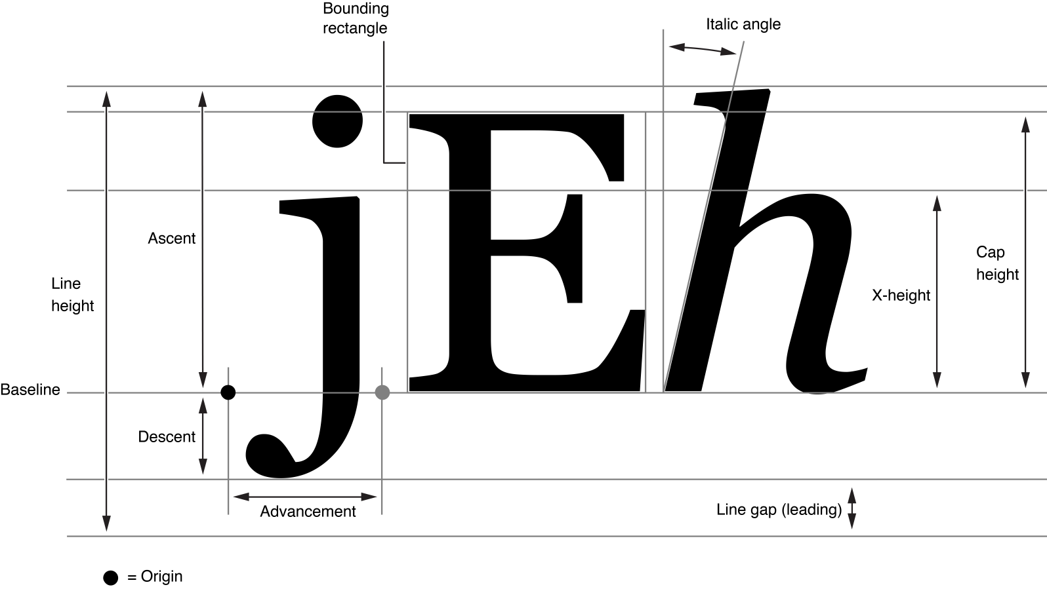
CSS measurement units
Font-size

Slide 27
CSS measurement units
ex- This value defines a measurement relative to a font's x-height. The x-height is determined by the height of the font's lowercase letter x.
in - Defines a measurement in inches.
mm - Defines a measurement in millimeters.
pc/pt – 1inch = 72 pt = 6picas ,
vh/vw/vmin – 1% of viewport height/width/min(height, width)

Slide 28
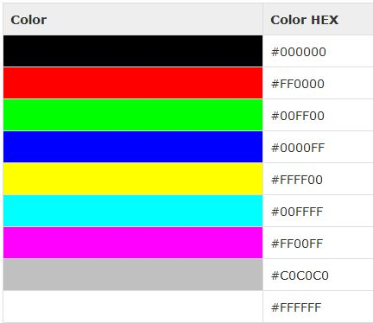
Colors
Hex Code
Red, Green, and Blue
rgb(0,0,0) -> white
rgb(255,255,0) -> ?

Slide 29
Dimensions
height property is used to set the height of a box.
width property is used to set the width of a box.
line-height property is used to set the height of a line of text.
Max/min-height/width property is used to set a maximum/minimum height/width that a box can be.

Slide 30
Texts
color - used to set the color of a text.
direction - used to set the text direction.
letter-spacing - used to add or subtract space between the letters that make up a word.
word-spacing - used to add or subtract space between the words of a sentence.
text-
indent /align/decoration - used to indent/align the text of a paragraph.
decoration - used to underline, overline, and strikethrough text.
transform - used to capitalize text or convert text to uppercase or lowercase letters.
white-space, text-shadow:

Slide 31
Font
font-family - used to change the face of a font.
font-style - used to make a font italic or oblique.
font-variant- used to create a small-caps effect.
font-weight - used to increase or decrease how bold or light a font appears.
font-size - used to increase or decrease the size of a font.
font – short hand

Slide 32
Exercise
Create a web page with Marvel super hero list with different formatting.
Iron man – Red, Arial Bold
Captain America – blue, Helvetica
Spider man – red and blue , Times new roman italic, underline
Hulk – Green, Verdana Bold, All caps
Thor – Red , Georgia Italic
Black widow – black, Arial
Hawk-eye – purple, Italic, Helvetica

Slide 33
Background
background-color: used to set the background color of an element.
background-image: used to set the background image of an element.
background-repeat: used to control the repetition of an image in the background.
background-position: used to control the position of an image in the background.
background-attachment: used to control the scrolling of an image in the background.

Slide 34
Borders
border-color: specifies the color of a border.
border-style: specifies whether a border should be solid, dashed line, double line, or one of the other possible values.
None/solid/dotted/ dashed …
border-width: specifies the width of a border.
Specific borders:
border-top/left/right/bottom

Slide 35
Margins/Padding
The margin property defines the space around an HTML element.
The padding property allows you to specify how much space should appear between the content of an element and its border
Specific margin/padding
margin/padding-top/left/right/bottom

Slide 36
Links
<style type="text/css">
a:link {color: #000000}
a:visited {color: #006600}
a:hover {color: #FFCC00}
a:active {color: #FF00CC}
</style>
<a href="">Link</a>

Slide 37
Using Tables
border-collapse: specifies whether the browser should control the appearance of the adjacent borders that touch each other or whether each cell should maintain its style.
border-spacing specifies the width that should appear between table cells.
caption-side captions are presented in the <caption> element.

Slide 38
Table CSS Example
<table>
<thead>
<td>Character</td> td>Actor </td>
</thead>
<tbody>
<tr>
<td>Mark Hamil</td> <td>Luke Skywalker</td>
</tr>
<tr>
<td>Han Solo</td><td>Harrison Ford</td>
</tr>
</tbody>
</table>
td{
border: 1px solid black;
}
thead
{
font-weight: bold;
}
table {
border-collapse: collapse;
}

Slide 39
Visibility
Visible: The box and its contents are shown to the user.
Hidden: The box and its content are made invisible, although they still affect the layout of the page.
<p style="visibility:hidden;">
This paragraph should not be visible.
</p>

Slide 40
Position
Position: relative/absolute/fixed
<div style="position:relative;left:80px;top:2px;background-color:yellow;">
This div has relative positioning.
</div>

Slide 41
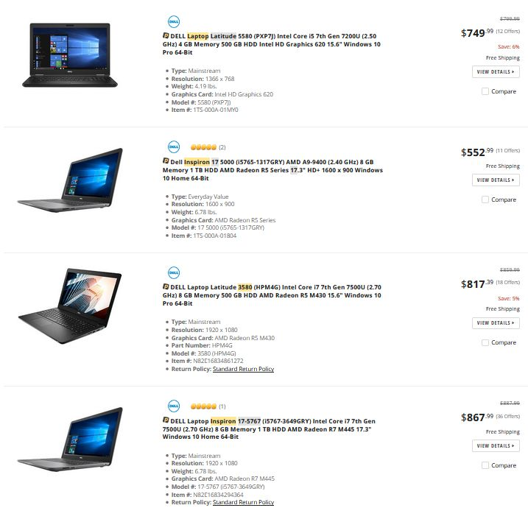
Exercise
Create this web page using
Tables, lists

Slide 42
Thank You

